Slide 1
Oscar Broker Portal Overview
Broker Training
2021

Slide 2
Training Topics
01 — How to Log-In
02 — Existing Broker - How to Log-In
03 — New Broker - Setting up an Account
04 — Broker Homepage
My Details
Start Selling
Agency Details
Locating your BoB
Menu Items
05 — Contact Us

Slide 3
Welcome to your Broker Portal
As a broker, your time is valuable, so we would like to make it easy for you to access the tools you need in one location.
In the Broker Portal you will be able to:
Get appointed
Update your account
Quote & enroll clients
Review & manage your BoB
View commissions
If you have any questions on the above, please reach out to the Oscar Broker Support team at hf-brokers@plusoscar.com,
or Health First Broker Services at 321.434.5265 or HFBroker@HF.org

Slide 4
How to Log-In

Slide 5
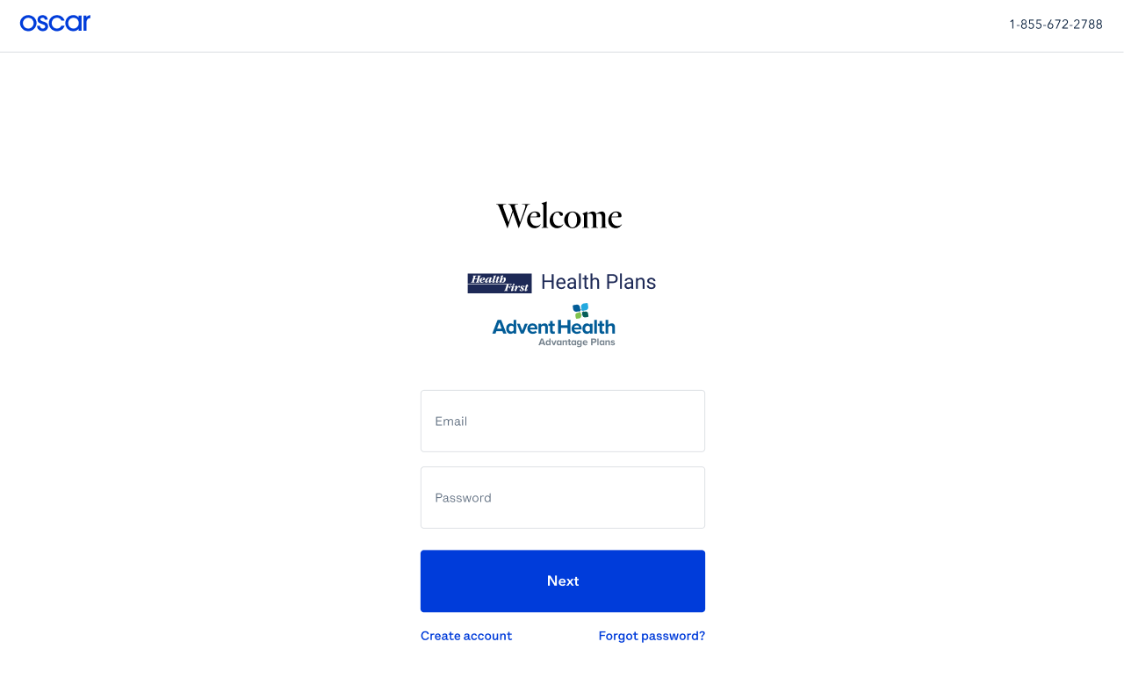
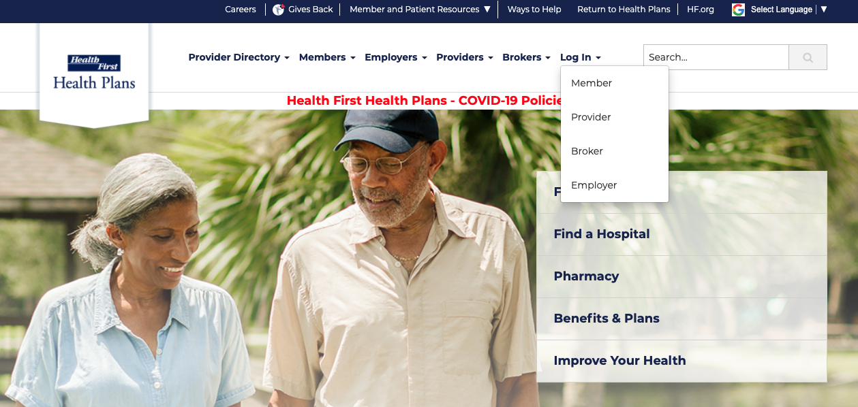
Broker Portal Location
The Broker Portal can be accessed in two ways:
Directly via https://healthfirst-brokers.hioscar.com/login
Or via the Health First Health Plans Website at myHFHP.org or myAHPlan.com
1
2

Slide 6
Existing Broker Log-In

Slide 7
Existing Brokers: Accessing your Broker Portal Account
If you’re an existing Health First broker, GOOD NEWS - your account has already been set up.
Future slides reflect existing broker login instructions. These same instructions will be coming in a future email.
Look for an email from HFBroker@HF.org
This email will confirm your account creation, and direct you to set up your password

Slide 8
Existing Brokers: Logging into your Broker Portal Account
1
Enter https://healthfirst-brokers.hioscar.com/login into your browser*
*Google Chrome recommended
2
Select “Create Account”

Slide 9
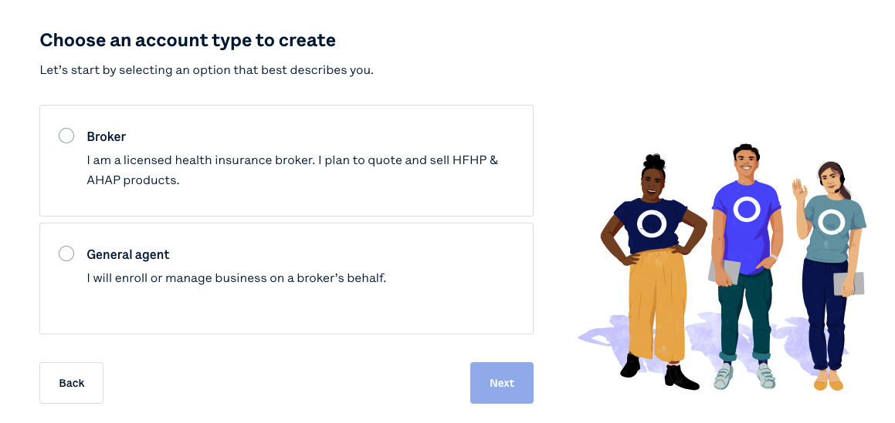
Existing Brokers: Logging into your Broker Portal Account
Select “Broker” to begin selling
General Agent’s/FMO’s will select the General Agent Option.

Slide 10
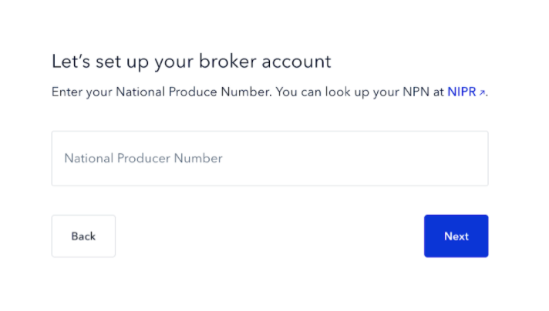
Existing Brokers: Logging into your Broker Portal Account
Enter your National Producer Number (NPN)

Slide 11
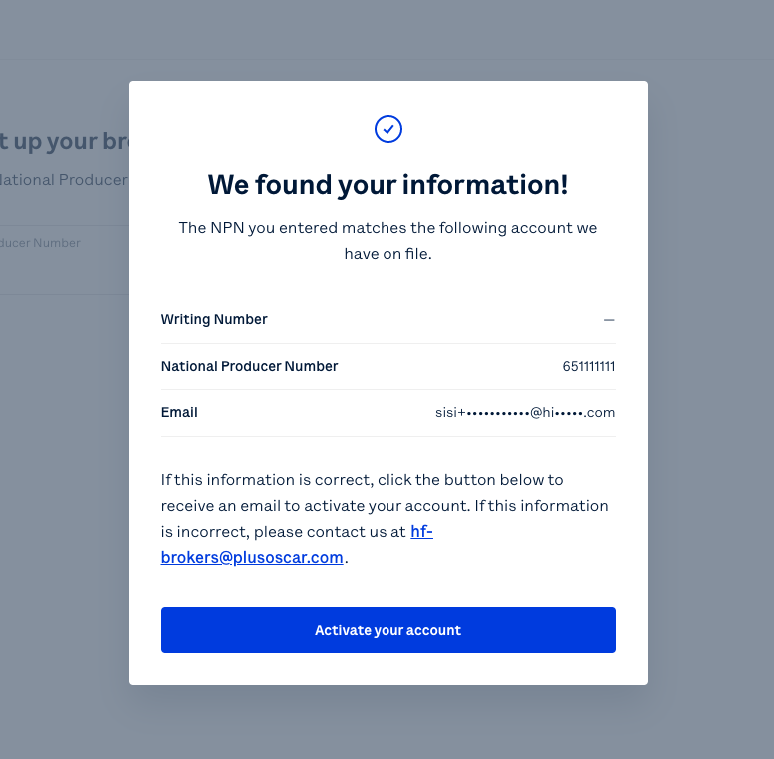
Existing Brokers: Logging into your Broker Portal Account
The portal will detect a NPN match, and show the following modal
Click “Activate your account”
Check your email for an Account Initialization email, and move through the authentication process as outlined in the email

Slide 12
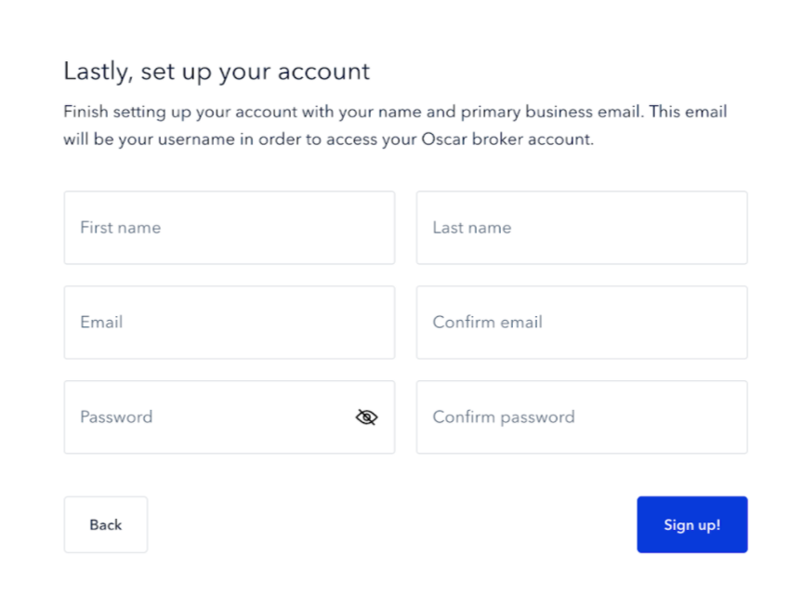
Existing Brokers: Logging into your Broker Portal Account
You will be directed back to your account to finalize setting up the account, and creating a password
Note: Existing Brokers will have their profiles created already with demographic and direct deposit information. Brokers should review this information for accuracy.

Slide 13
New Broker Account Creation

Slide 14
New Brokers: Creating your Broker Portal Account
1
Enter https://healthfirst-brokers.hioscar.com/login into your browser*
*Google Chrome recommended
2
Select “Create
Account”

Slide 15
New Brokers: Creating your Broker Portal Account
Select “Broker” to begin selling Health First Health Plans Products
General Agent’s/FMO’s will select the General Agent Option.

Slide 16
New Brokers: Creating your Broker Portal Account
Enter your National Producer Number (NPN)

Slide 17
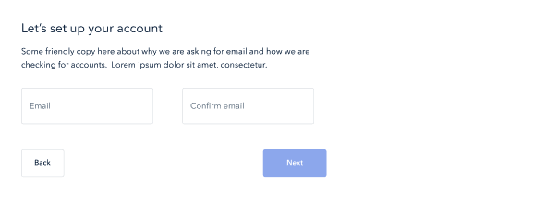
New Brokers: Creating your Broker Portal Account
Enter and confirm your Email address

Slide 18
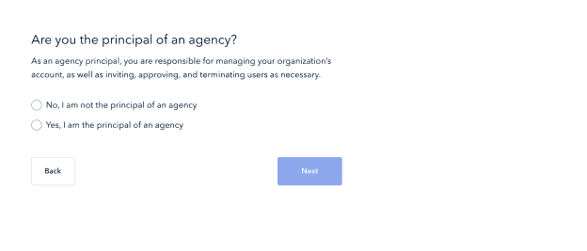
New Brokers: Creating your Broker Portal Account
Confirm “Yes” or “No” if you are the principal of your agency

Slide 19
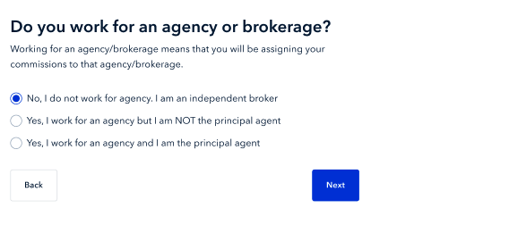
New Brokers: Creating your Broker Portal Account
Confirm your Agency status

Slide 20
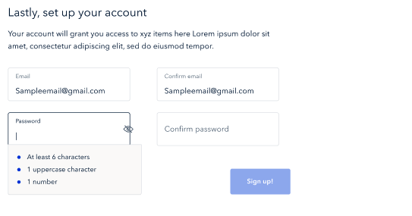
New Brokers: Creating your Broker Portal Account
Set up your broker account with Email & Password
Your password must include:
At least 6 characters
1 uppercase character
1 number

Slide 21
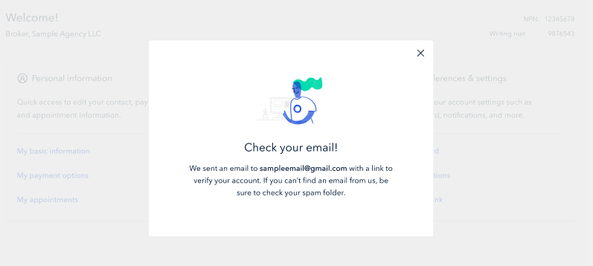
New Brokers: Creating your Broker Portal Account
Verify your account via your email used to create your account

Slide 22
Broker Homepage
Notes:
Now that we have discussed account creation, lets take a look at the portal.

Slide 23
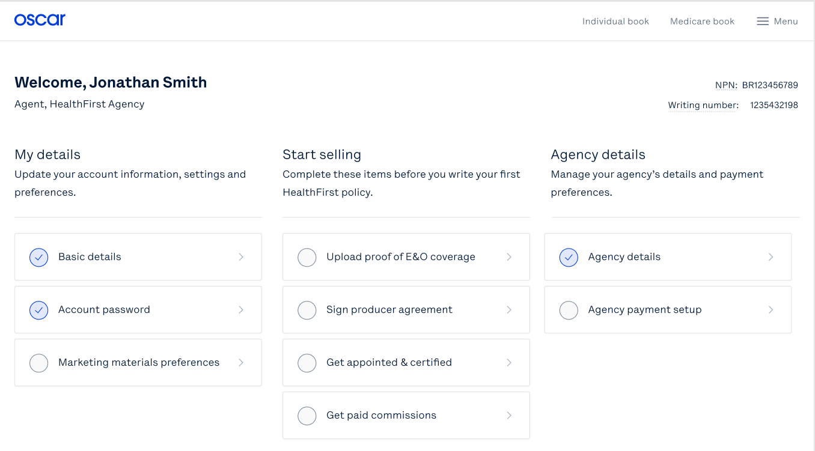
Broker Account:
Your Broker Account Homepage will allow you to view and update personal details, ready to sell documents, and agency details.
Agent, Health First Agency
Complete these items before you write your first Health First policy.

Slide 24
Broker Account: My details
The My details section will allow you to:
Update your personal details
Reset your password
Set marketing material preferences
Enter payment information
Agent, Health First Agency
1
Complete these items before you write your first Health First policy.

Slide 25
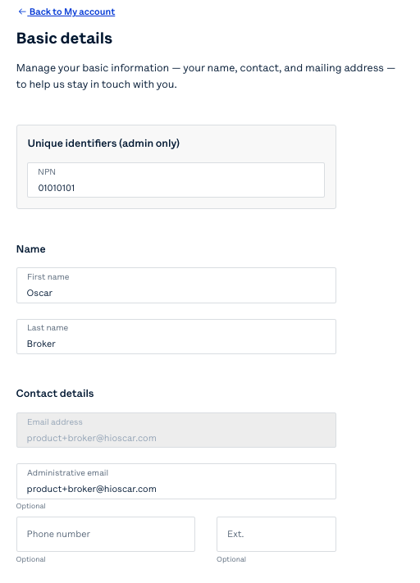
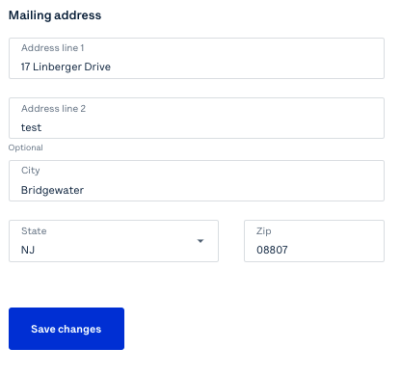
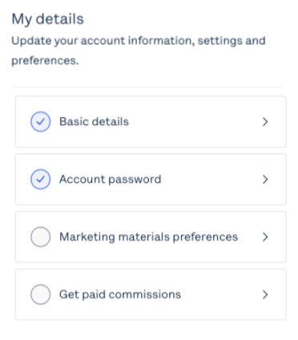
Broker Account: My details
Update your Name, Contact Details & Mailing Address in Basic Details

Slide 26
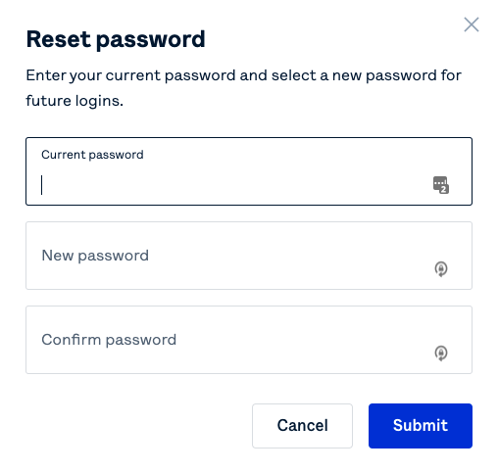
Broker Account: My details
Clicking Account password will force a pop-up that allows you to reset your current password

Slide 27
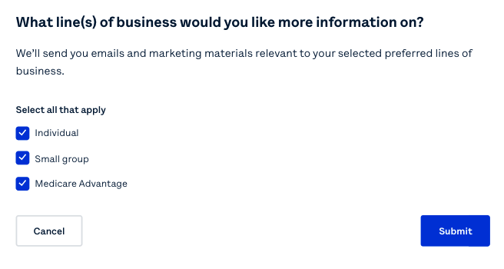
Broker Account: My details
Marketing materials preferences will allow you to select which emails and marketing materials you would like to receive based on preferred lines of business

Slide 28
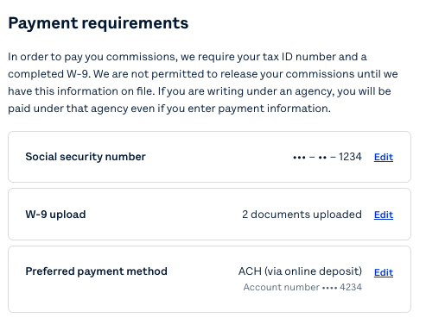
Broker Account: My details
Get paid commissions will prompt you to enter your social security number, upload your W-9, and include your preferred payment method.
Health First brokers will only have a Direct Deposit (ACH) payment method option available.

Slide 29
Broker Account: Start selling
The Start selling section requires you to:
Upload proof of E&O coverage
Sign the producer agreement
Get appointed to sell IFP
Get appointed and certified to sell Medicare
Agent, Health First Agency
2
Complete these items before you write your first Health First policy.

Slide 30
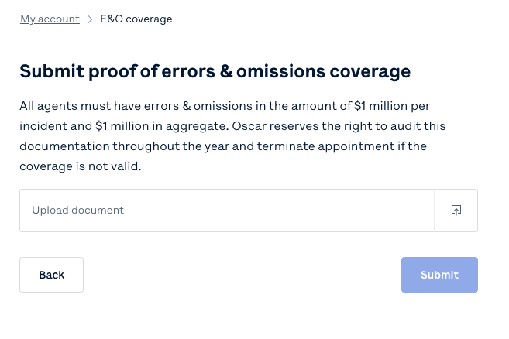
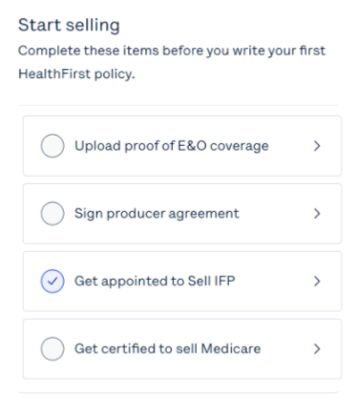
Broker Account: Start selling
Complete these items before you write your first Health First policy.
In order to edit or remove your current proof of errors & omissions coverage, please email @plusoscar.com
Upload proof of E&O coverage will ask you to upload your E&O document, select who the policy covers, and enter the dates for which the policy is valid for.
To edit or remove the current E&O document, you will need to email: hf-brokers@plusoscar.com

Slide 31
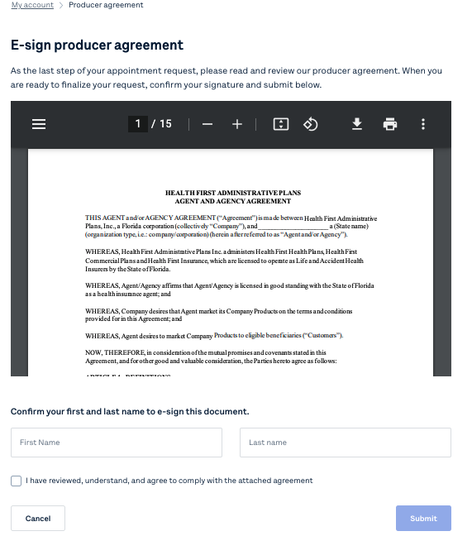
Broker Account: Start selling
Sign producer agreement will prompt you to review, and digitally sign the Health First producer agreement.
Note: the Commission Schedule is part of this agreement
Complete these items before you write your first Health First policy.

Slide 32
Broker Account: Start selling
Complete these items before you write your first Health First policy.
To get appointed to sell IFP, you will be able to request your FL appointment and have it processed within 5-7 business days.
Additional details to be shared in the How to Get Appointed supplementary training.

Slide 33
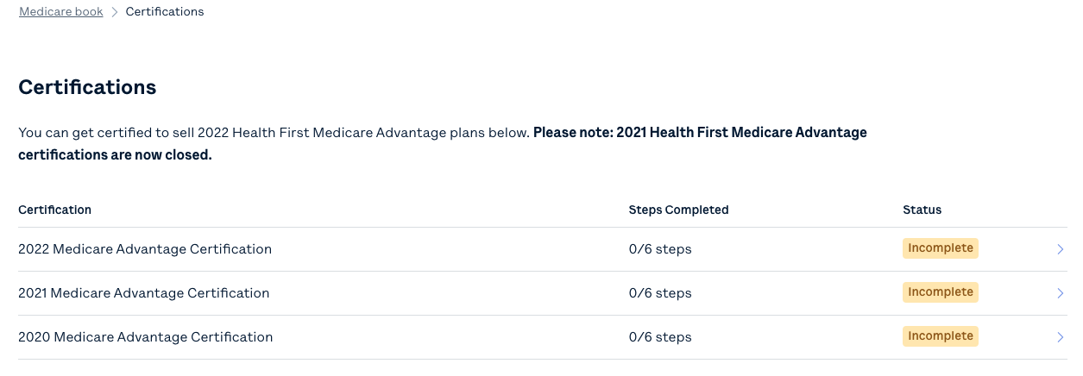
Broker Account: Start selling
Complete these items before you write your first Health First policy.
To get certified to sell Medicare, you will be able to begin the certification process to sell 2022 Medicare Advantage plans.
Appointment and certification will take place for MA in this step.
Additional details to be shared in the How to Get Appointed supplementary training.

Slide 34
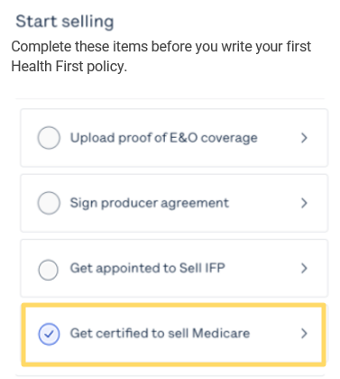
Broker Account: Get Certified to Sell Medicare
If you have already completed your Health First Required Medicare Certification (HFMC) and provided your AHIP Certification to Health First by August 20, your information will be transferred to Oscar. You will see this information in your Oscar Broker Portal by September 5.
If you have not provided your HFMC or AHIP certifications by August 20, you will be required to complete all requirements through the Oscar Broker Portal, shown here under Get certified to sell Medicare.

Slide 35
Broker Account: Agency details
The Agency details section allows you to:
Update agency details
Enter agency payment information
Agent, Health First Agency
3
Complete these items before you write your first Health First policy.

Slide 36
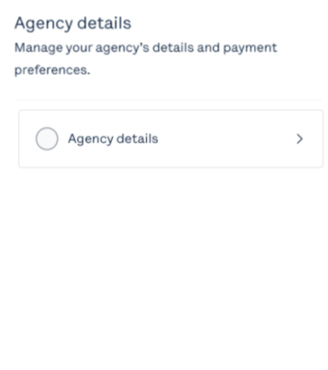
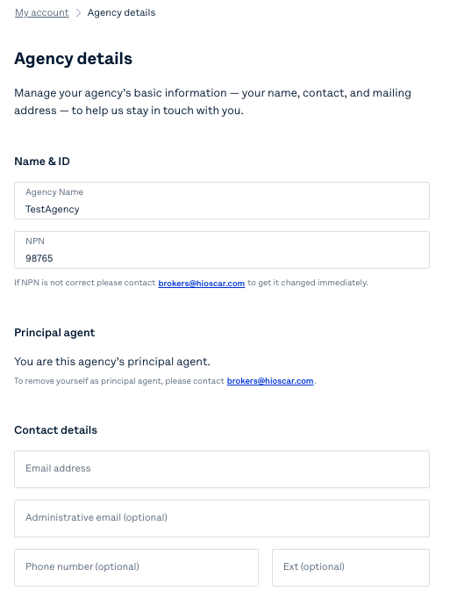
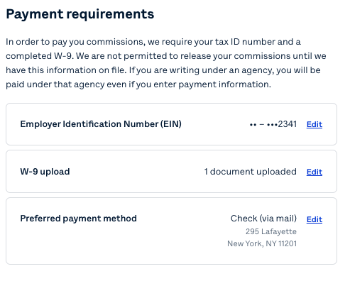
Broker Account: Agency details
Agency details will allow you to update and manage your agency’s basic information if you are the principal broker

Slide 37
Broker Account: Locating your BoB
4
To view your Book of Business, select either Individual book or Medicare book via the top navigation bar of the broker portal
Agent, Health First Agency
Complete these items before you write your first Health First policy.

Slide 38
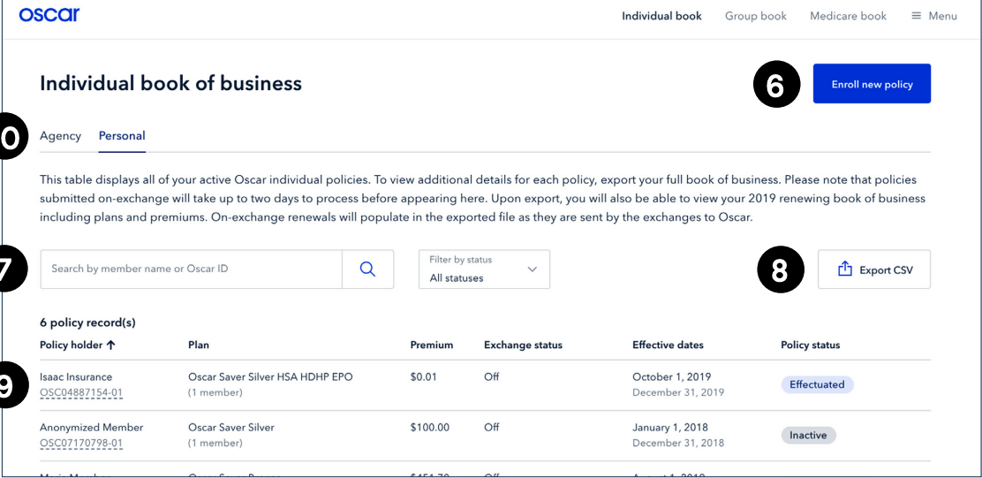
Broker Account: Managing your BoB
Quote & enroll clients in minutes
Search by name, or filter by status to find clients
Click on any client to view more details including plan information, dependents, contact information, billing & payment history
Export your BoB to see more details
For agency principals: View and manage any policies attributed to your agency
1
5
This table displays all of your active Health First individual policies. To view additional details for each policy, export your full book of business. Please note that policies submitted on-exchange will take up to two days to process before appearing here.
2
4
3
These functionalities will also be available for Medicare Advantage BoB as well
*For demonstration purposes ONLY, Oscar sample data is shown above

Slide 39
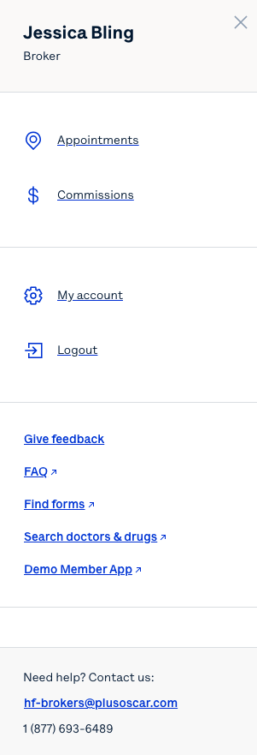
Broker Account: Menu Items
5
Agent, Health First Agency
Complete these items before you write your first Health First policy.

Slide 40
Oscar’s Broker Support Team is here to help
✓ Broker account support
✓ Appointment & certification support
✓ Commissions escalations
✓ Eligibility inquiries
✓ Member inquiries & support
✓ Network/Rx support
Monday through Friday 8:00am - 6:00pm EST
hf-brokers@plusoscar.com
hf-brokercommissions@plusoscar.com
877-693-6489

Slide 41
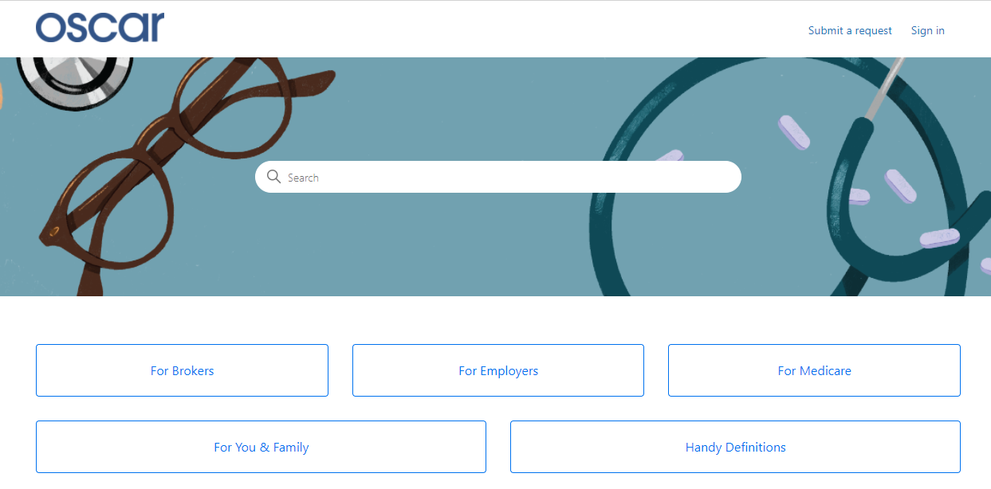
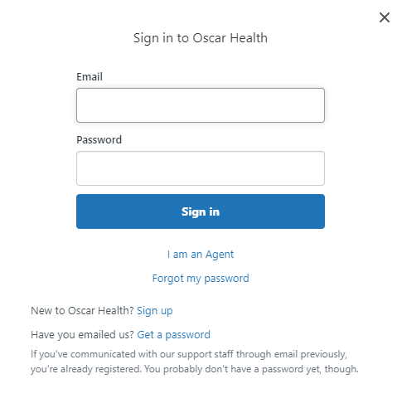
Creating your Zendesk Account to connect via email with Oscar In order for brokers to communicate with Oscar through the designated emails provided, you will need to create an account through Zendesk. Follow the below steps.
Go to Oscar’s Zendesk Help Center
Click "Sign in" from the top right
A pop-up window will prompt you to sign in. If you don’t have an account, select "Sign up" next to "New to Oscar Health?"
Submit your full name and email address
Click the blue "Sign up" button. You will be receiving an email to complete account set up.
From your inbox, you will see an automated email with the subject "Welcome to Oscar Health." Click the unique link to complete creating your password.
You can now successfully communicate to/from, via email, with Oscar.

Slide 42
Health First Health Plans Broker Services is available: Monday through Friday 8:00 a.m. to 5:00 p.m.
For questions contact us at: 321.434.5265 or HFBroker@HF.org

